Slide 1
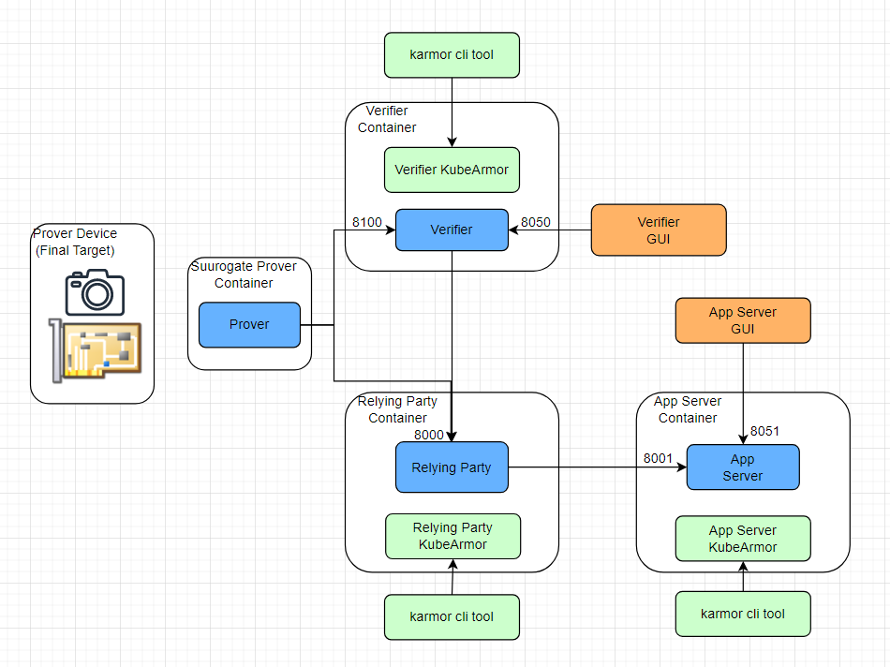
Security Enforcement with KubeArmor
Problem Statement
Container Isolation, hardening
Dev/DevOps needs an understanding of the apps behavior.
Harden workloads based on known patterns
Least permissive policy settings. Ability to protect from 0days

Slide 2

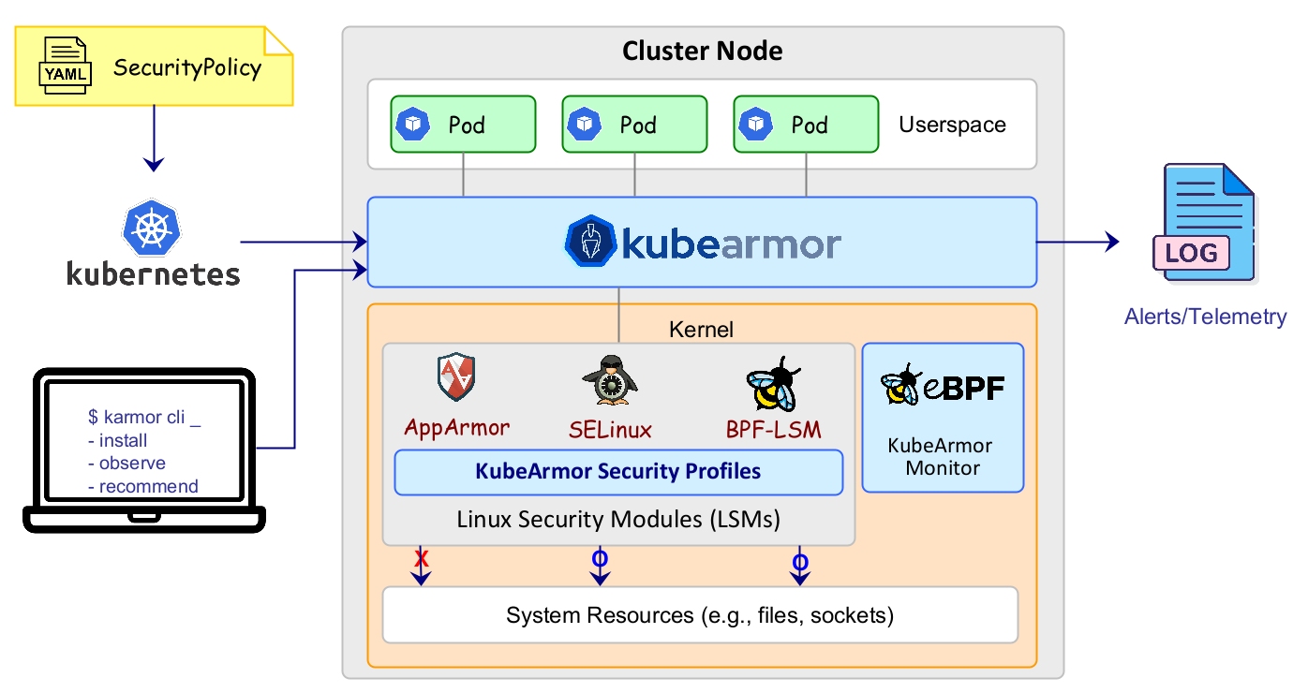
KubeArmor
Use of eBPF to knit kernel events with k8s metadata
LSMs for policy enforcement
Inline Mitigation
https://github.com/kubearmor/
kubearmor.io

Slide 3
Securing SEDIMENT with KubeArmor
App Behavior
Recommend hardening policies
Discover least
privilege policies
Visibility into SEDIMENT application behavior
Identify the process forking behavior of the application
Identify sensitive asset access of SEDIMENT
Identify network access required by SEDIMENT
Protection policies for Gateway deploying SEDIMENT Verifier.
Process Whitelisting: Do not allow processes to execute within SEDIMENT container outside of the given spec.
Network Access: Only allow SEDIMENT binaries to use the network primitives
Check SEDIMENT configuration files and create a security net around SEDIMENT’s sensitive assets.
Use host hardening policies to protect host.

Slide 4
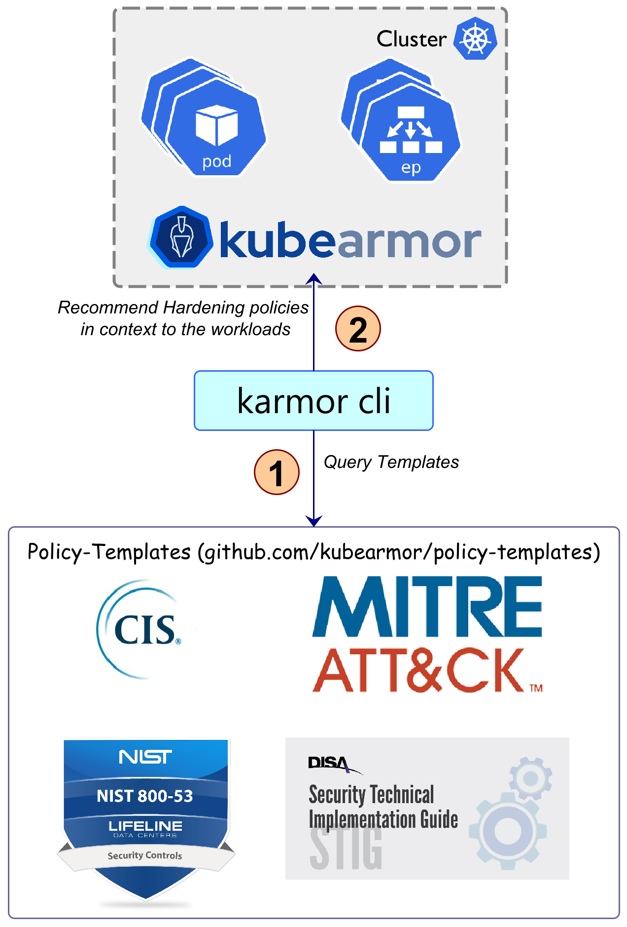
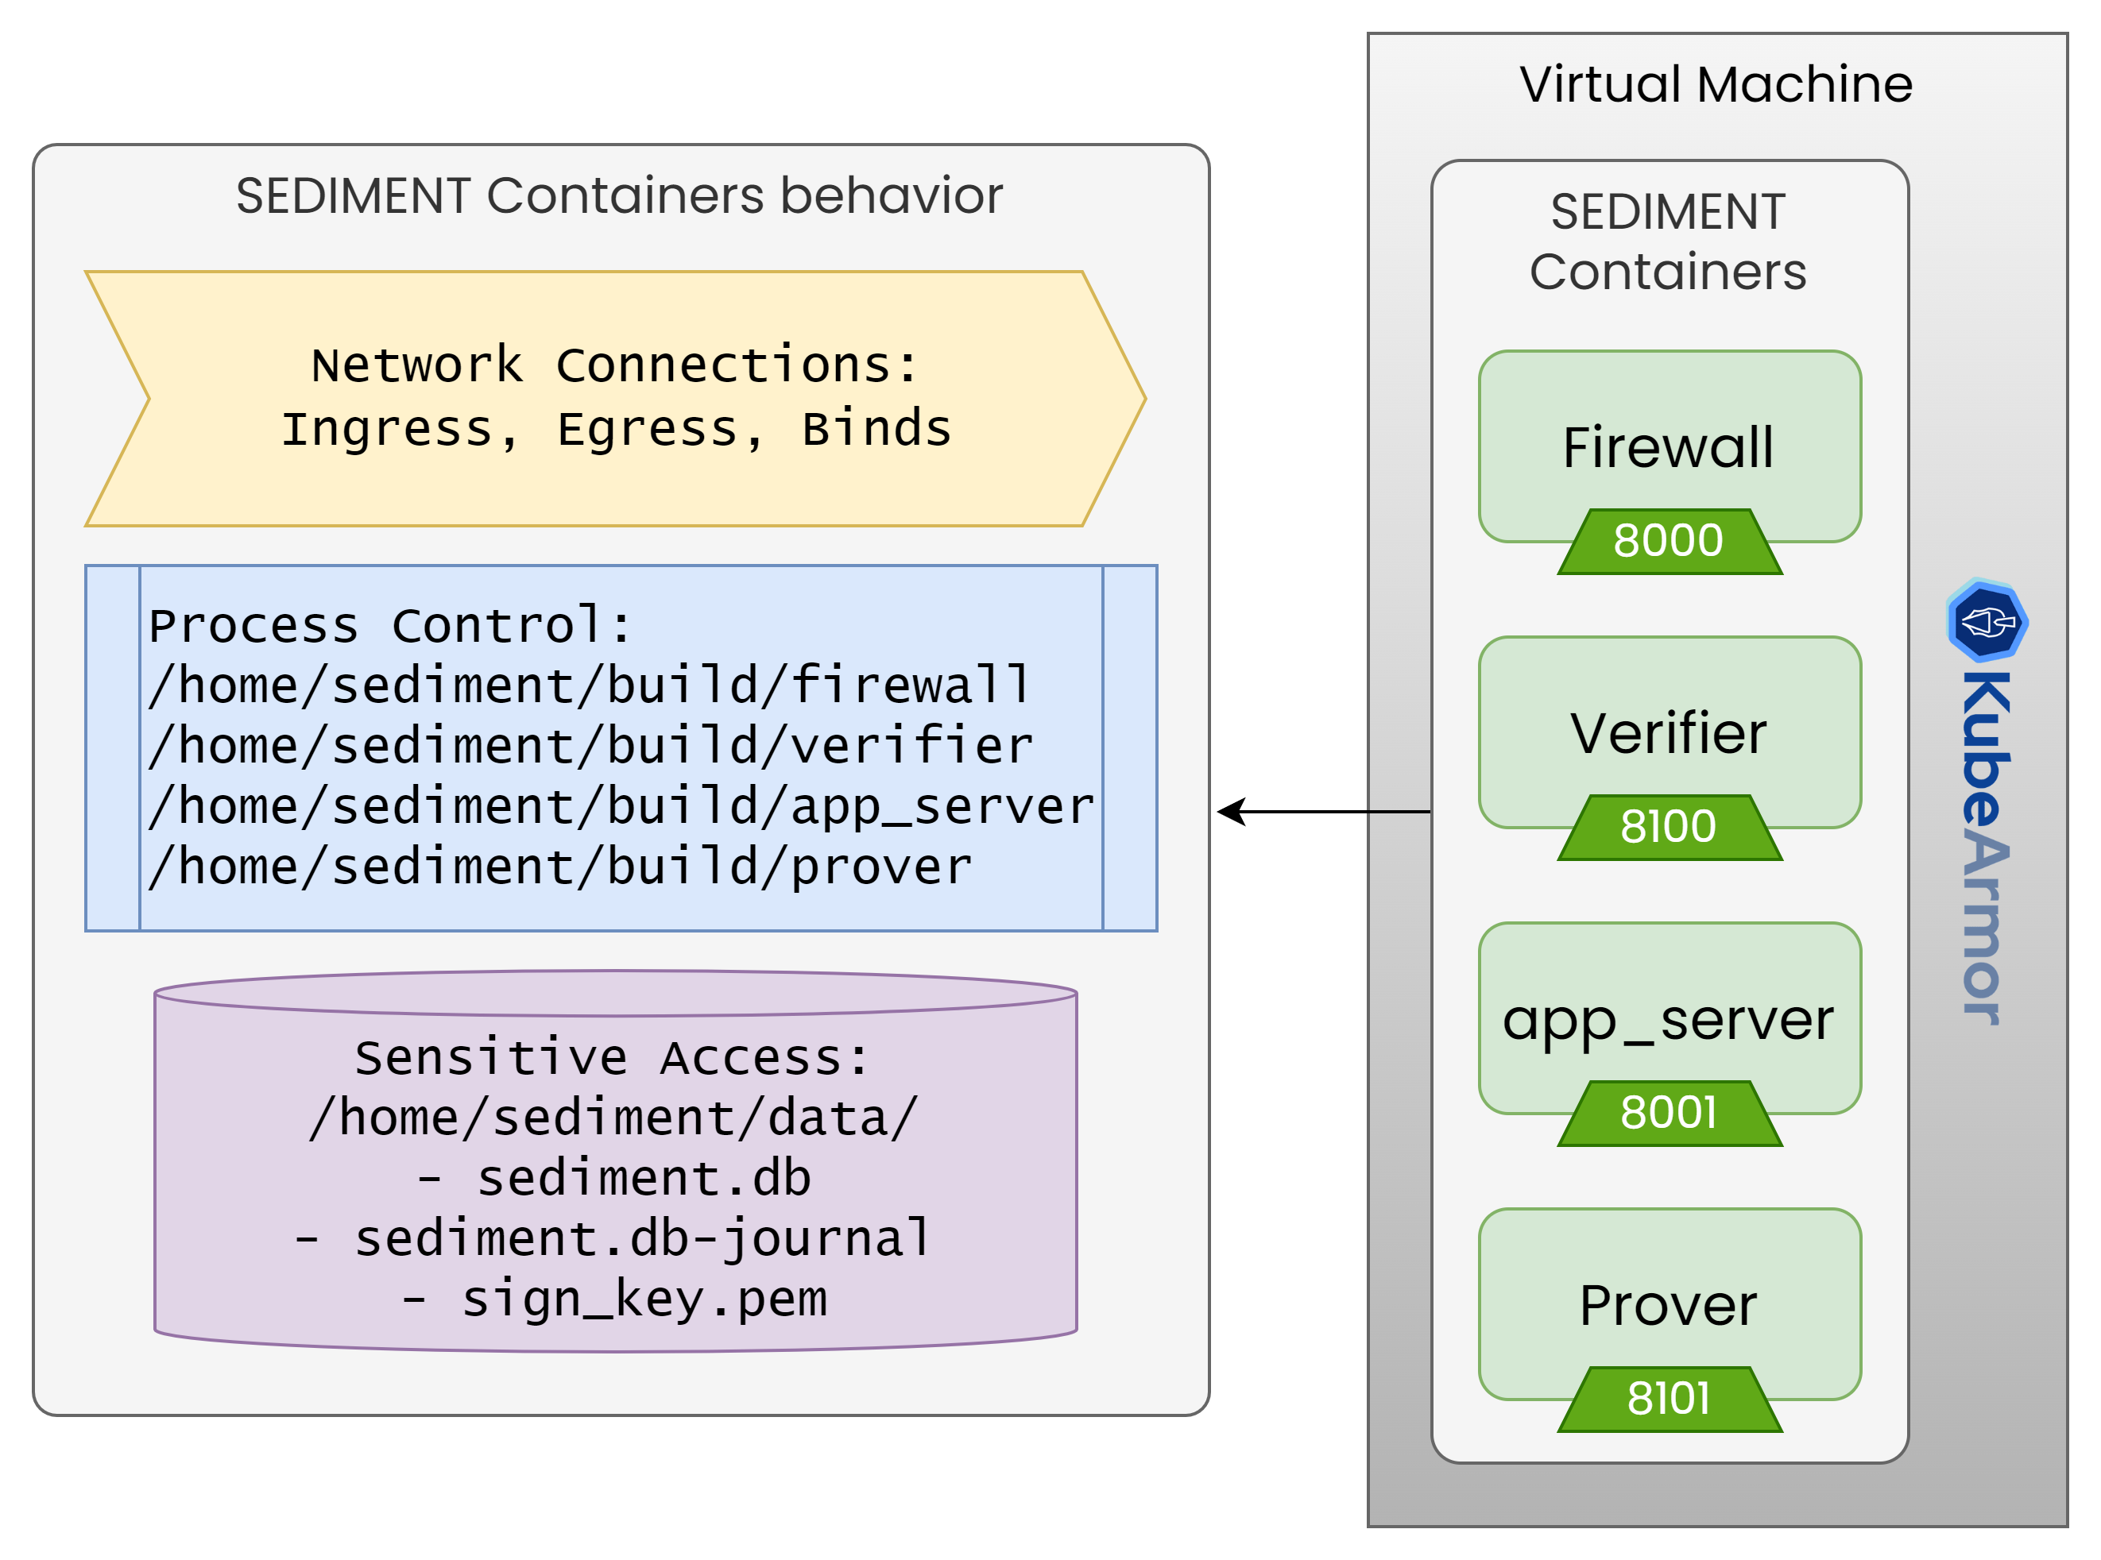
App Behavior, Compliance policies

Slide 5
Zero Trust Policy for SEDIMENT
apiVersion: security.kubearmor.com/v1
kind: KubeArmorPolicy
metadata:
name: firewall
spec:
severity: 1
selector:
matchLabels:
kubearmor.io/container.name: sediment-demo
file:
matchDirectories:
- dir: /home/sediment/data/
recursive: true
action: Block
- dir: /
recursive: true
- dir: /home/sediment/data/
recursive: true
fromSource:
- path: /home/sediment/build/firewall
process:
matchPaths:
- path: /home/sediment/build/firewall
- path: /home/sediment/build/verifier
message: “Zero trust policy violated”
action: Allow
Allow specific behavior, deny/audit rest.
Only allow sediment binary to access sensitive data.
Only allow sediment binaries to execute within the container.

Slide 6
Status & Roadmap
K8s (managed, unmanaged, on-prem) and cloud native protection
Integrated with Edge platforms
LF Open Horizon
Intel Smart Edge
[Roadmap] Adopt 5G security controls and create policy templates, based on
MITRE FIGHT (in-progress)
ENISA 5G Security Controls
[Roadmap] 5G workload specific policy templates for hardening

